Slide 1

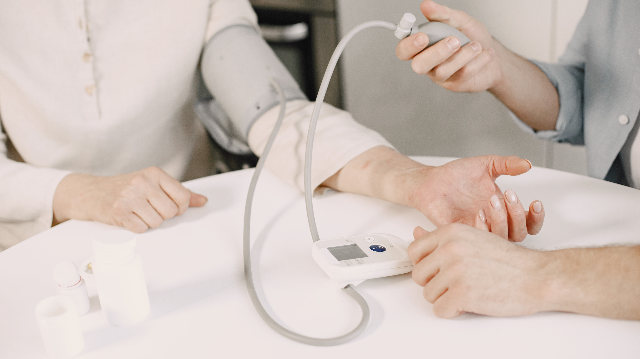

Allowing Animal Clinical Trials Is Saving the Life of Humans
Presented by Albert

Slide 2


“The moral cost of not doing animal research is the lives lost and the suffering that will not be alleviated because we don’t have the knowledge that comes from such research,”
Dr. David Jentsch

Slide 3

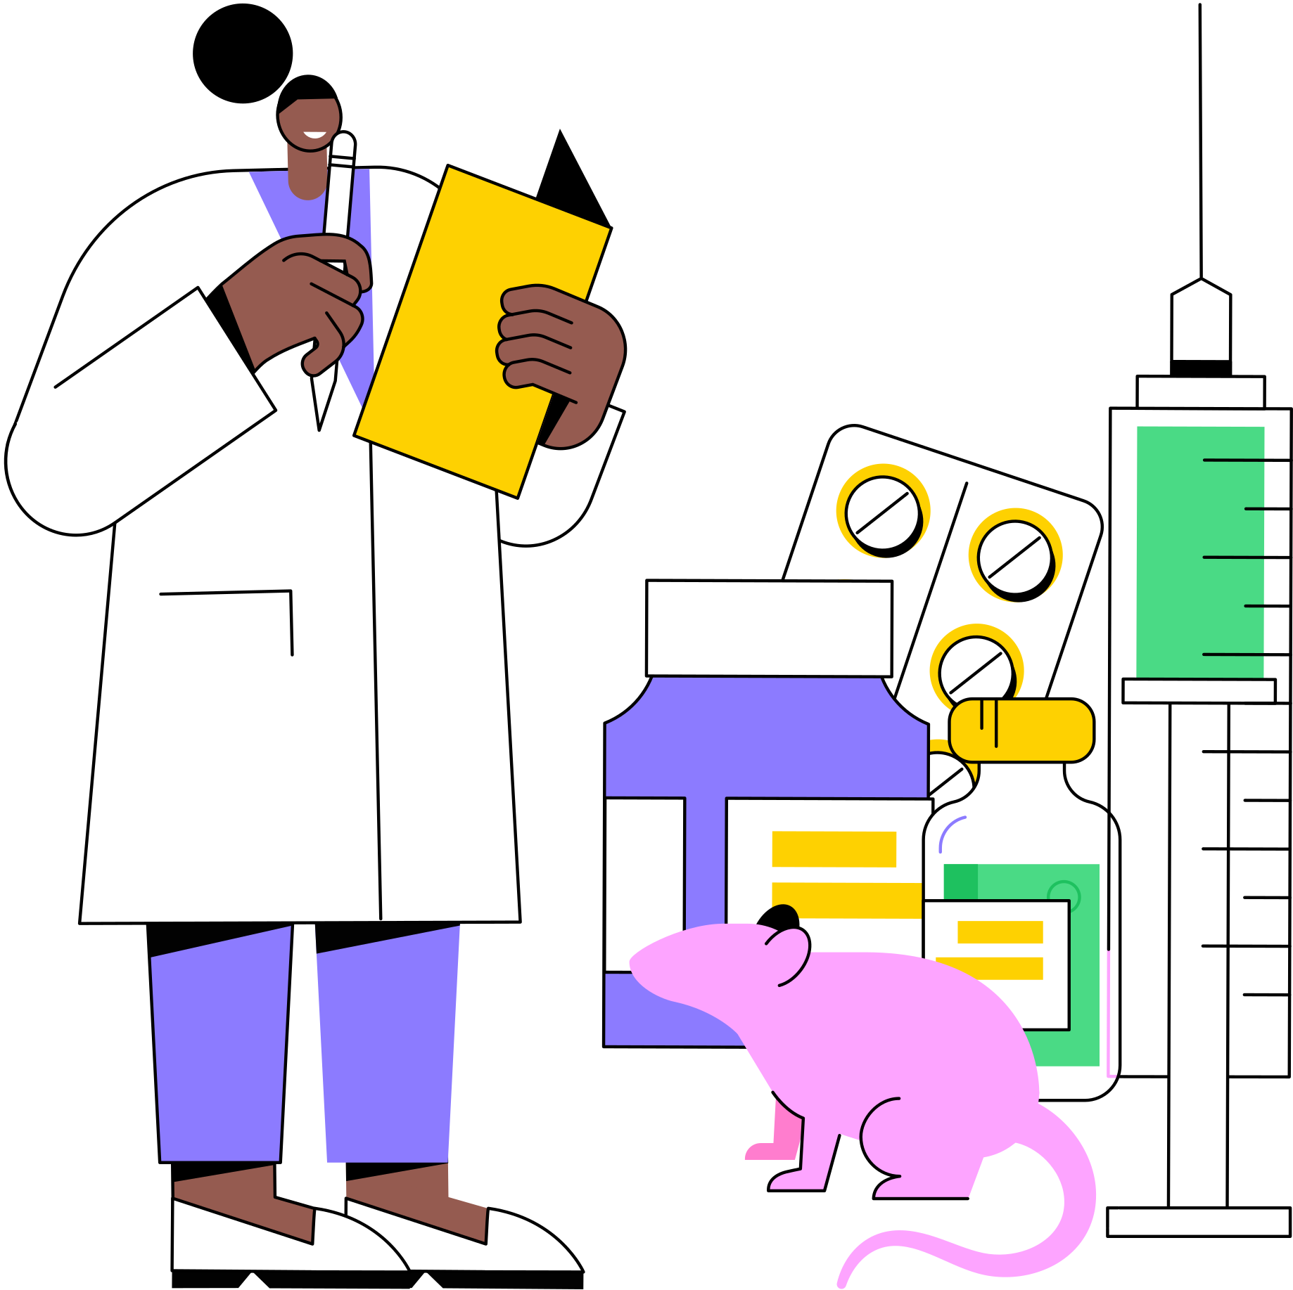


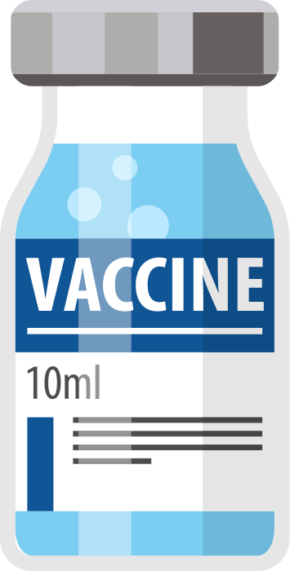
Definition

Slide 4
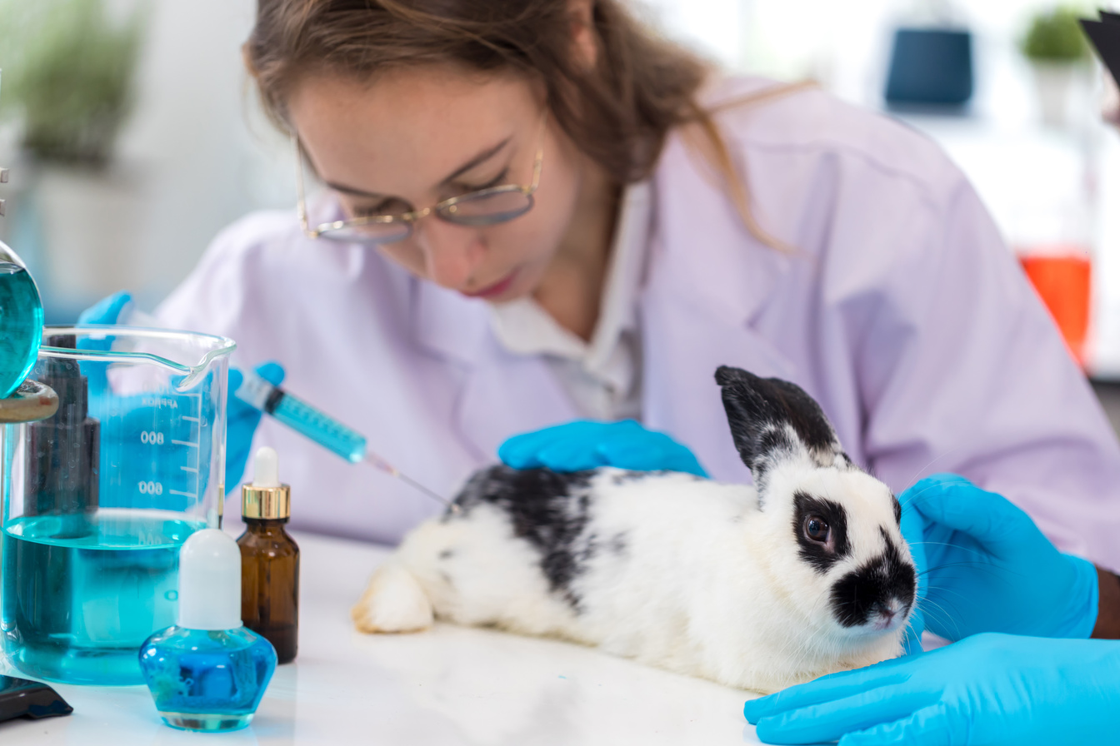
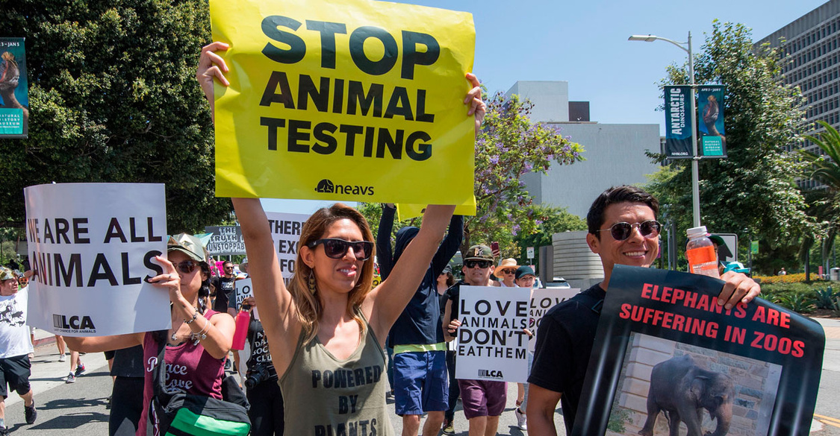
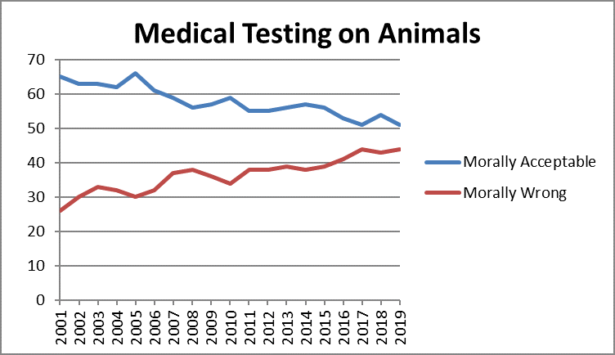
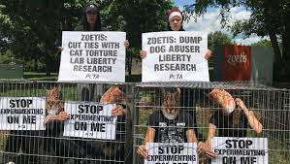
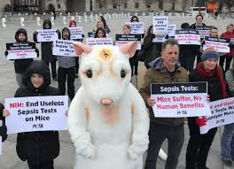
Background

Slide 5
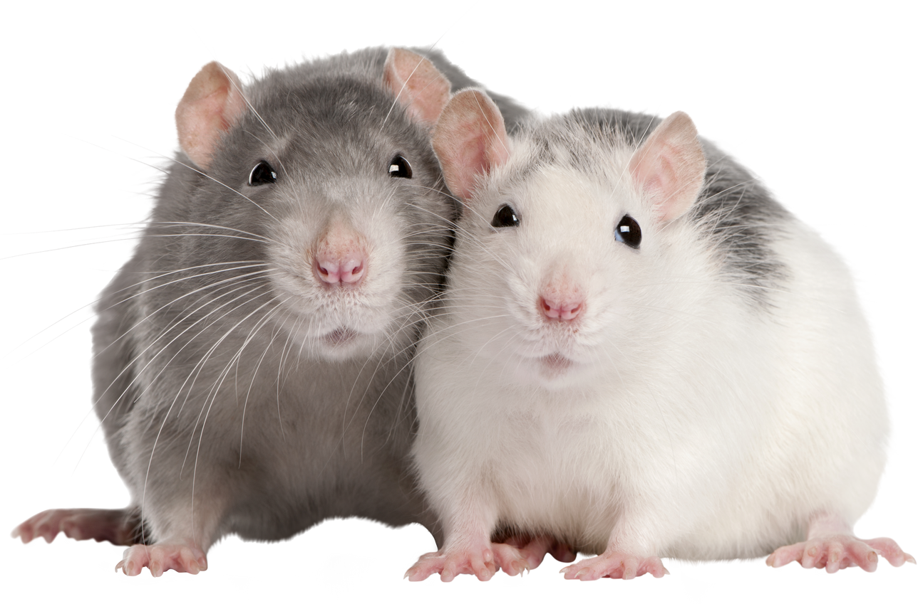
1
1st Arguement
Medication Safety
Animal testing
2
2nd Argument
Alternative Technology
3
3rd Argument
Animal Ethics
4
4th Counterargument
5
Conclusion

Slide 6
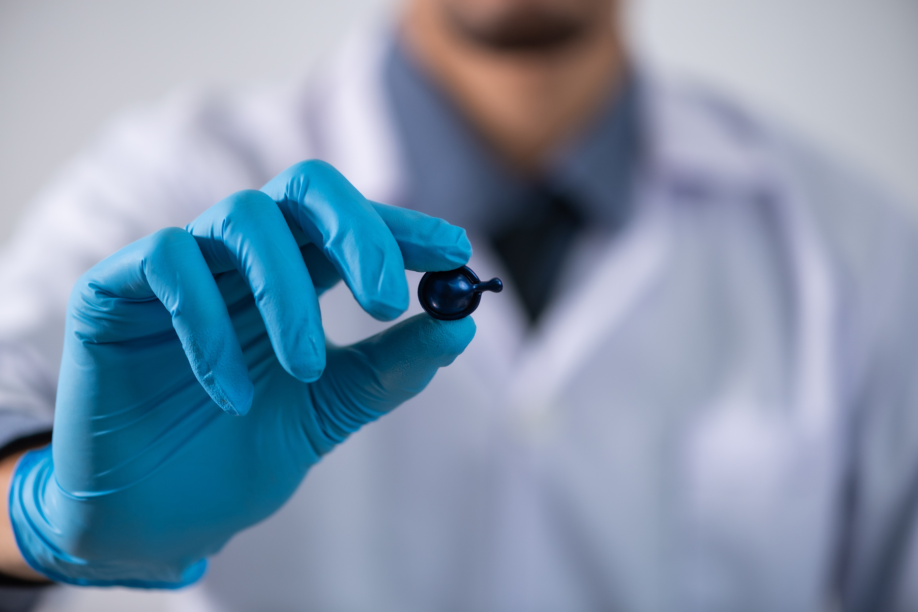
PART 1
Medication Safety

Slide 7
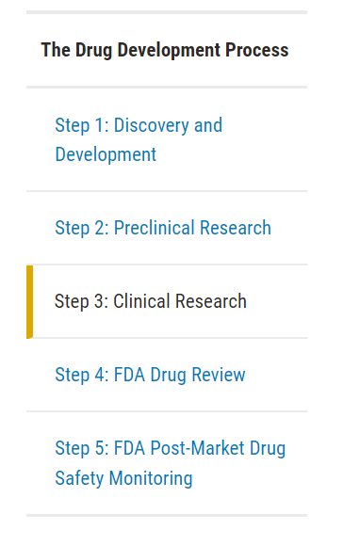
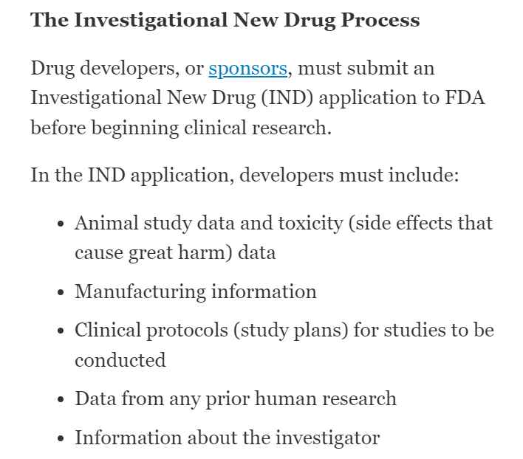

Scan it and get the article

Slide 8
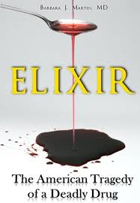

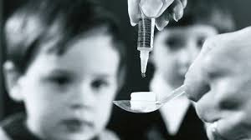

1937,
The U.S.
new elixir to treat strep throat
killing more than 100 people (Anthes, 2023).
1955
The U.S.
Salk polio vaccine
10 children died (Danish, 2020).

Slide 9
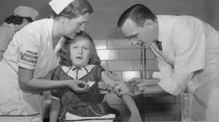
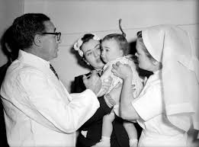
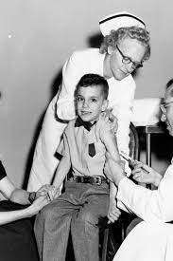
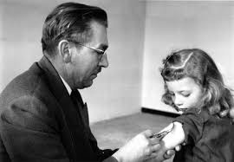


Slide 10

PART 2
Alternative Technology

Slide 11
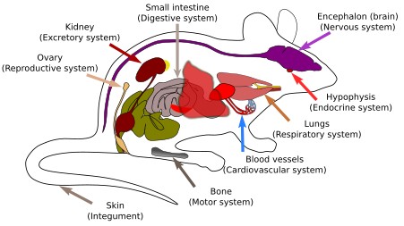
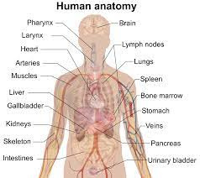
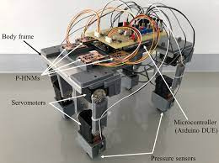

Slide 12
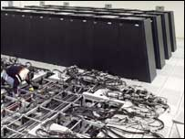
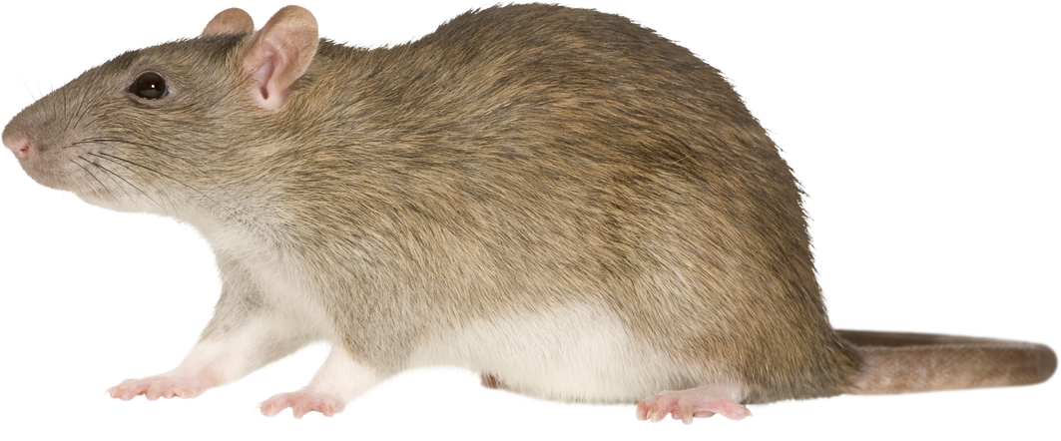

US researchers have simulated mouse brains on computers, and they find it hard to simulate because a real mouse brain is thought to have about eight million neurons, and there is not enough computer memory to present these neurons.

Slide 13
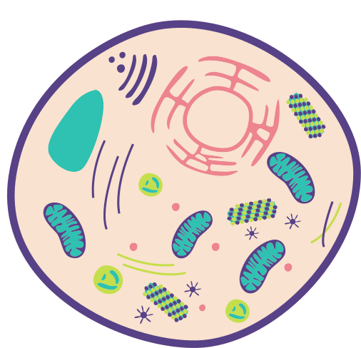
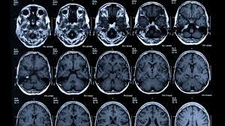
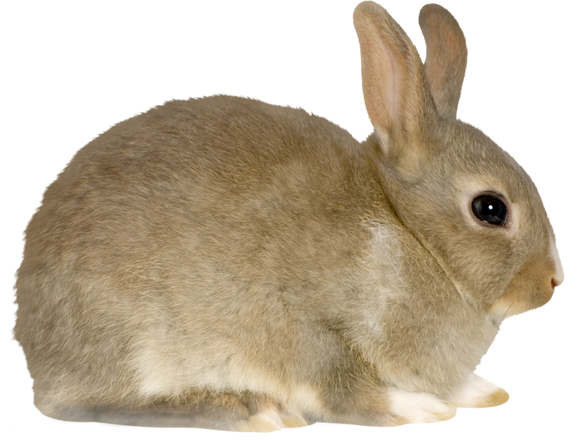
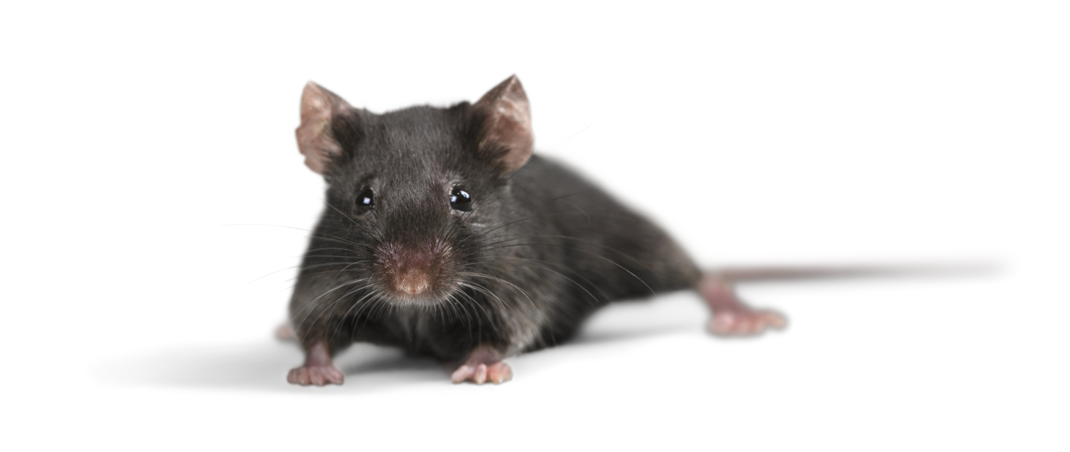

Slide 14
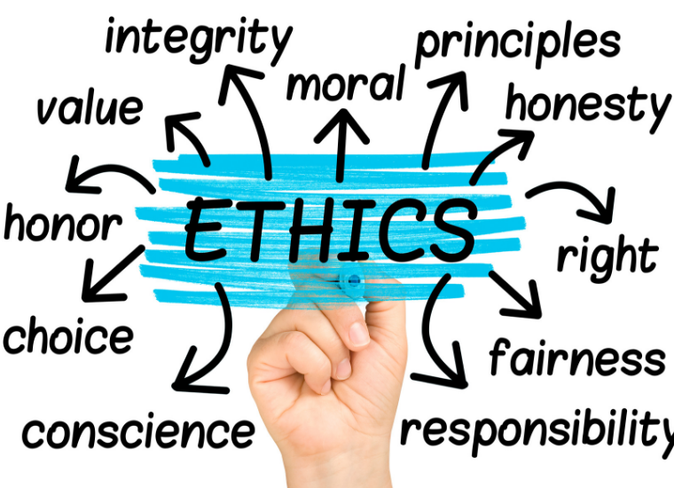
PART 3
Animal ethics

Slide 15


Slide 16



Scientific research emphasizes specific principles designed to protect individual and group interests based on broad, perceived benefits to humanity (Ferdowsian & Beck, 2011).

Slide 17
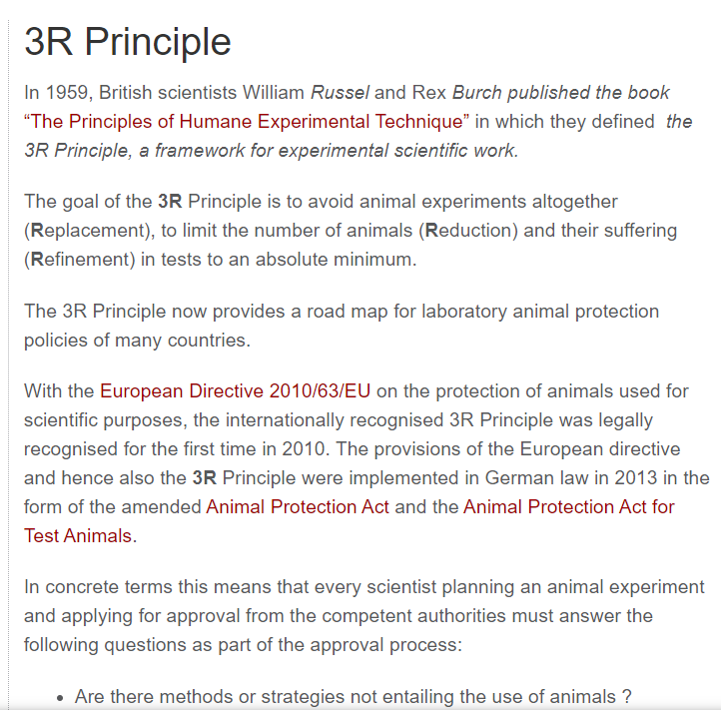
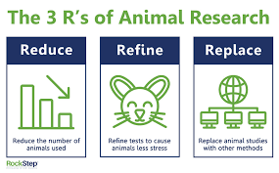
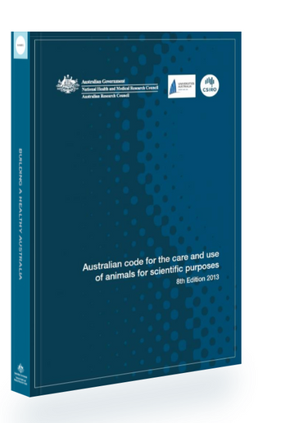


Slide 18
PART 4
Counterargument

Slide 19

animals and humans are all creatures born on earth that should not be treated differently; since scientists did not get animals’ permission as they do with humans, they cannot force animals to take the trials.

Slide 20
Unstated assumption
animals are capable of understanding the purpose and risks of the research they are involved in
Ignore the fact

Slide 21
CONCLUSION

Slide 22
1
1st Arguement
Medication Safety
Animal testing
2
2nd Argument
Alternative Technology
3
3rd Argument
Animal Ethics
4
4th Counterargument
5
Conclusion

Slide 23
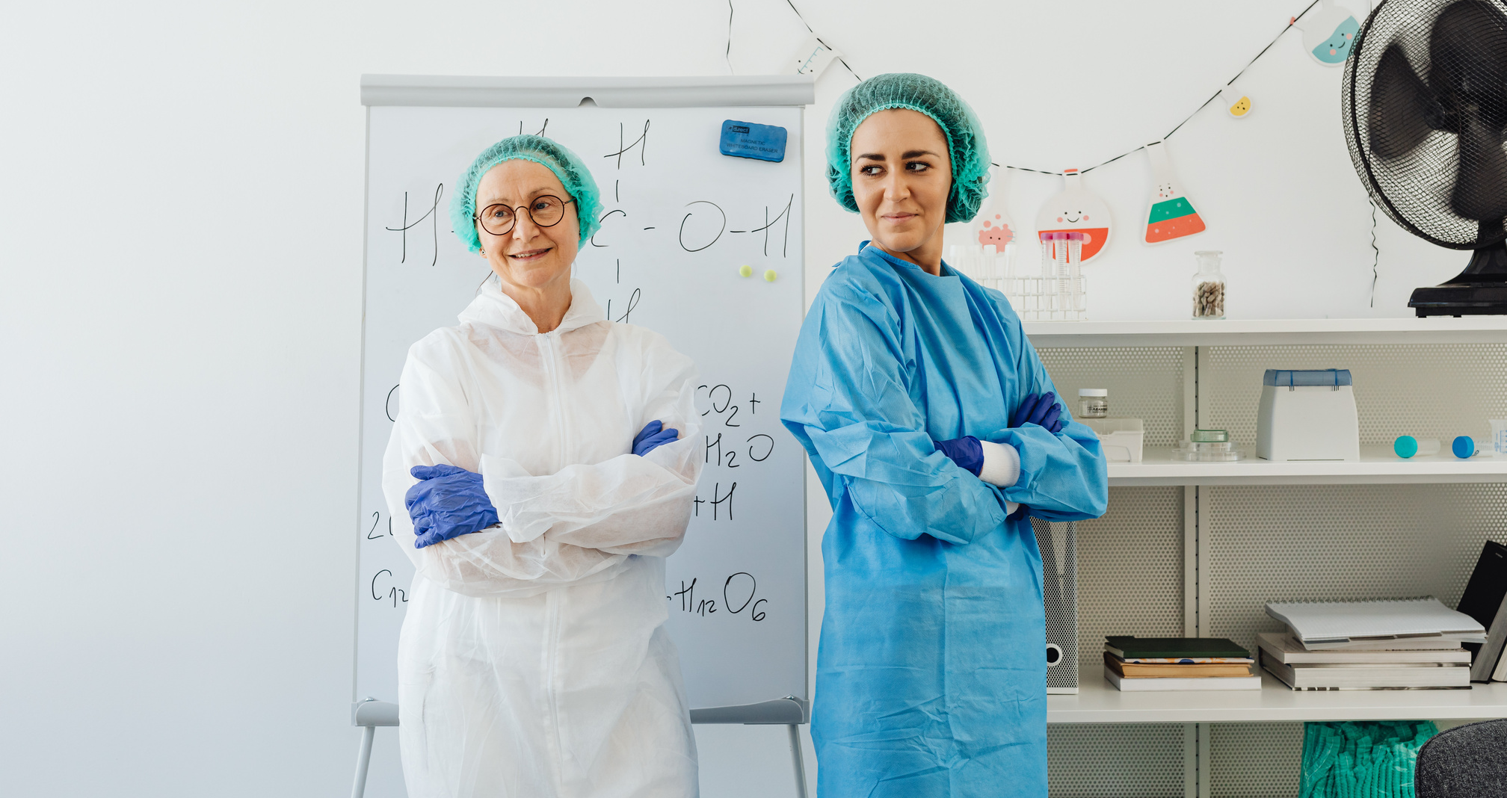

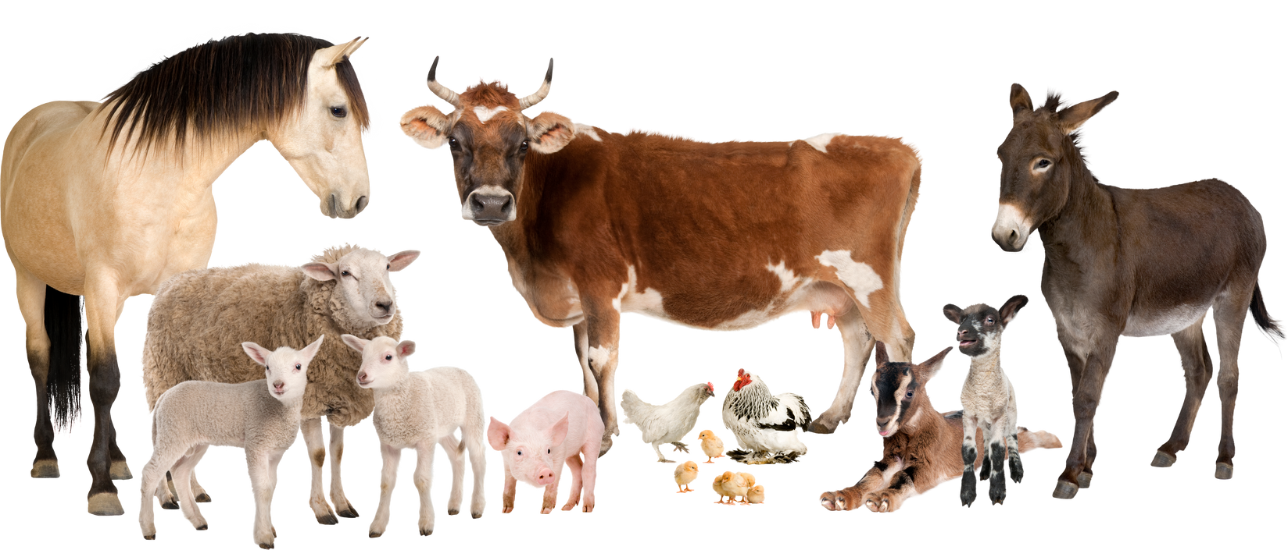
Animal Testing Save the Life

